Slide 1

Digital Lifestyle Habit Tracker
Dr. Ebru Çankaya
CS-3354.001
Rhea Bhatia
Cameron Meyer
Mark Mondt
Jackson Nestelroad
Andrew Sylvester
Prathyusha Thiruvuri

Slide 2
Objective
To provide a time-tracking application that will be more effective in decreasing screen time compared to other applications.
Application features:
Track time on apps
Limit time on apps or app categories
Data visualization
Users can invite others to view and monitor their activity, allowing friends and family members to hold each other accountable in lowering screen time.
Our application offers a new way to decrease screen time, because it’s easier to seek goals together rather than alone.

Slide 3

Comparison to Competition
App Feature | Social Fever | SPACE | AppDetox | Screen Time | Digital Wellbeing & Parental Controls | Digital Lifestyle Habit Tracker
Set Limits per app
Lock user out of app
Parental Controls
Accountability Partner(s)/ Friends
Export Data
Present Data Visualization
Lock User out of phone during off time
Override Limit
Notes:
Prathyusha

Slide 4
Functional Requirements
Track and save time spent on an allowed application from the moment it is opened to the moment it is closed.
Set daily or weekly time limits for specific applications, categories, or application groups.
Invite accountability partners by email or phone number to view and manage app usage data, time limits, and restrictions.
Request that an accountability partner override application time limits and restrictions.
Present visualizations for usage data in the form of a table, bar chart, pie chart, line chart, or word cloud.
Export daily, weekly, monthly, yearly, or all-time data to a .csv, .xls, .pdf, .json, or .xml file.
Notes:
Cameron

Slide 5
Non-Functional Requirements
Product Requirements
Usability Requirement —A simple tutorial will be available to the user on initial startup and in the help menu. All tutorials or help pages within the application will be no more than five steps. Training time for the application should be no more than ten minutes.
Organizational Requirements
Development Requirement — The application shall be developed for cross-platform mobile devices using the Dart programming language and Flutter UI development kit.
External Requirements
Regulatory Requirement — A user may request for all screen time data and account information to be deleted at any time. This requirement is in compliance with the European Union’s General Data Protection Regulation.
Notes:
Andrew
For our non-functional requirements we’ve written out all 12, but here are three we felt highlighted important aspects of our software.
First is the usability requirement, we want to make sure

Slide 6
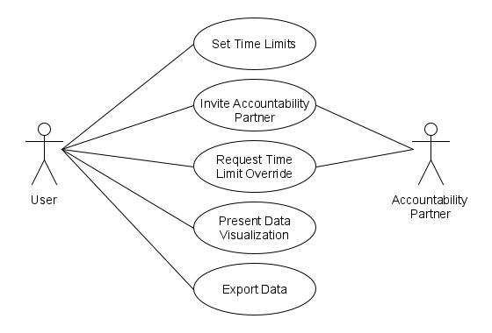
Use Case Diagram
Notes:
Mark

Slide 7
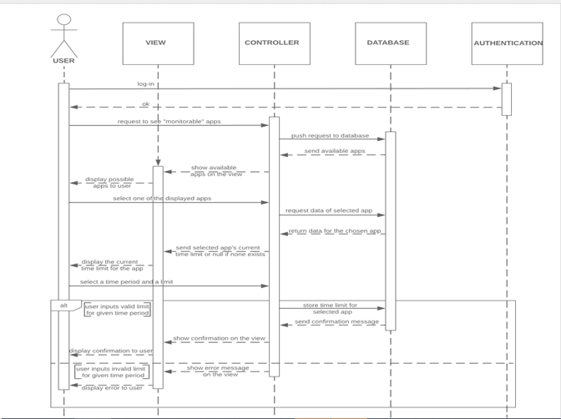
Sequence Diagram- Setting Time Limits
Notes:
Rhea Bhatia

Slide 8
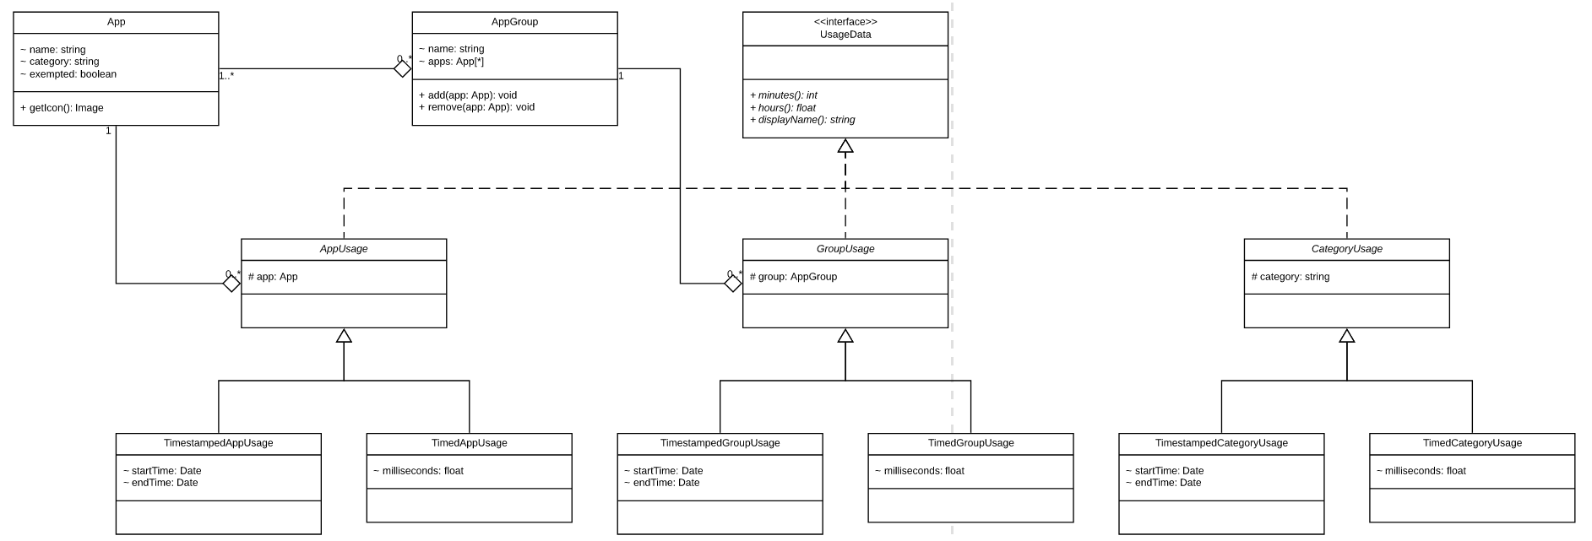
Class Diagram
Notes:
Jackson
Internal representation of the user’s data as they are using the app
Three related subclasses – app, group, category
Each has two subclasses – timestamped and timed

Slide 9
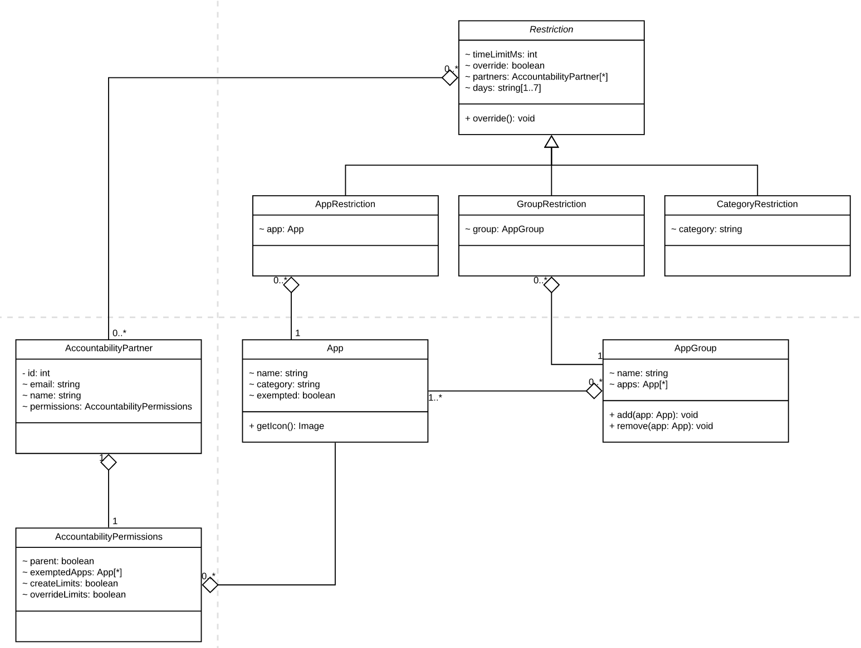
Class Diagram
Notes:
Jackson
Restrictions

Slide 10
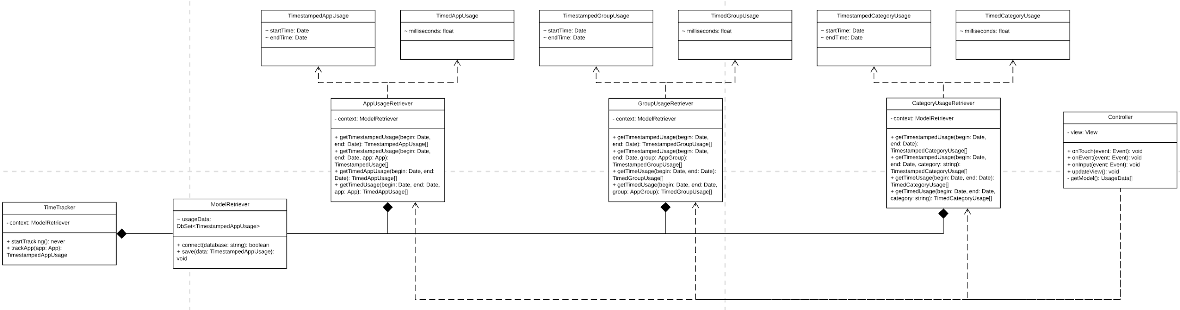
Class Diagram
Notes:
Jackson
Model retriever and time tracker

Slide 11
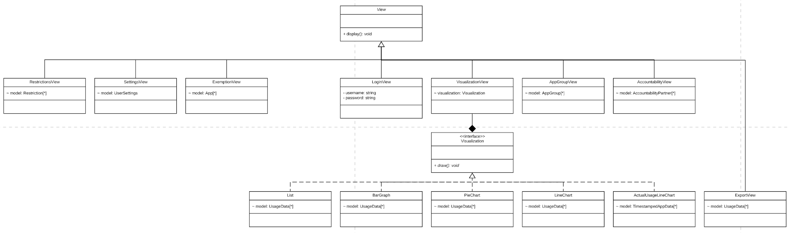
Class Diagram
Notes:
Jackson
Views

Slide 12
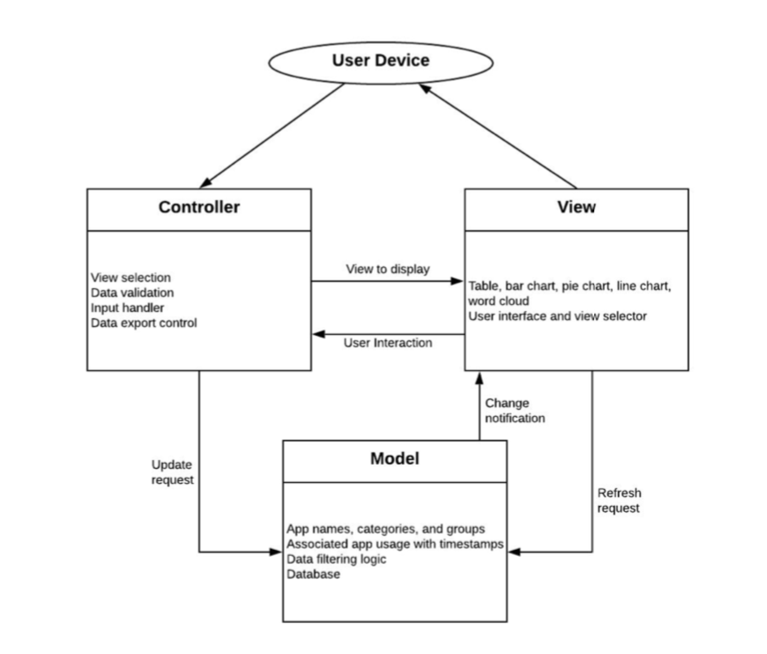
Architectural Design
MVC Pattern
Best because app centers around data usage and subsequent presentation of data
Model: application database
View: visualization
Controller: user input, validation, data control
Notes:
Prathyusha

Slide 13
Test Plan
Test that time limits are being set properly.
Partition 1 (Time Limit > 0): A time limit is set and the app is unlocked.
Partition 2 (Time Limit = 0): No time limit is set and the app is locked.
Partition 3 (Time Limit < 0): No time limit is set and the app stays unlocked.
Notes:
Andrew
We plan to test our software thoroughly throughout development. An example of such is a unit test on time limits being set properly as its passed into one of our functions. To test this we used black box technique equivalence partitioning. Our first partition is when a positive time limit is passed in, which should result in a time limit being set and the app remaining unlocked. Our second partition is if a value of zero is passed in, and if so, no time limit is set and the app will be locked indefinitely. And lastly, if a negative value is passed in, there should be no time limit set and the app will remain unlocked.

Slide 14
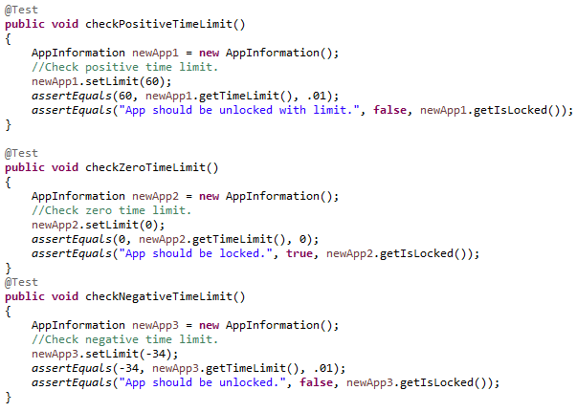
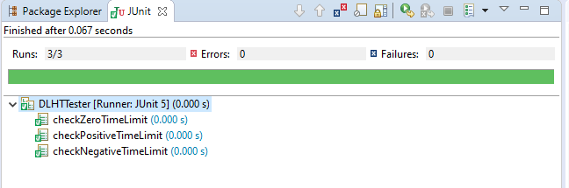
Test Plan (Cont.)
Notes:
Andrew
Here’s an example of the code for our partitions in java, and on the right is the JUnit test results for each partition test.

Slide 15
Project Timeline
Month 1
Market Research
Requirements Gathering
Cost Estimations
Month 3
Iteration 1
Time Tracking
Time Limits
Month 5
Iteration 3
Data Presentation
User Feedback
Maintenance
User Feedback
Month 2
Back-end Development
Database Design
UI Design
Month 4
Iteration 2
Accountability Partners
App Groups
Month 6
Iteration 4
Data Export
User Feedback
Notes:
Jackson
Estimated project timeline
Entire process – six months
First month – solidify the requirements that will guide the entire application process
Second month – back-end development, database design, and UI design to prep for development of the real product, the mobile application
Next four months – broken into iterations to progressively build our product
Each iteration lasts exactly one month
First week – review of previous iteration, user feedback, and upcoming goals
Second, third week – implementation of new features
Fourth week – user testing, collect user feedback to guide next iteration
Early iterations implement the most essential features to get user feedback as early as possible
Later iterations build on the previous product
Though these later iterations may shift in purpose if user feedback introduces new needed features not originally covered in the requirements
After four development iterations, the application will be ready for deployment and will enter a period of developer maintenance with constant user feedback

Slide 16
Function Point
 | Function Category | Count | Low Complexity | Average Complexity | High Complexity | Count * Complexity
1 | Number of User Input | 7 | 3 | 4 | 6 | 7*3=21
2 | Number of User Output | 19 | 4 | 5 | 7 | 19*7=133
3 | Number of User Queries | 12 | 3 | 4 | 6 | 12*3=36
4 | Number of data files and relational tables | 3 | 7 | 10 | 15 | 3*7=21
5 | Number of external interfaces | 4 | 5 | 7 | 10 | 4*10=40
Notes:
Mark

Slide 17
Function Point
GFP = 251
FP = GFP * 1.06 = 266.06
Time = FP/(Productivity * Developers) = FP/(8.75*4)
The development proper will take 8 weeks

Slide 18
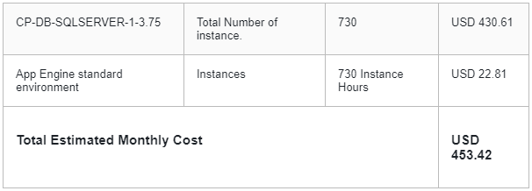
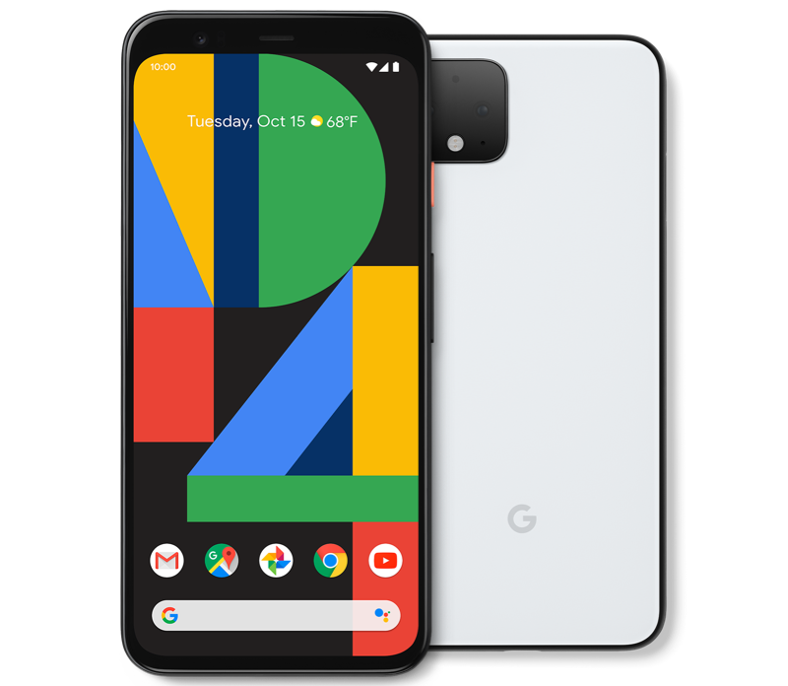
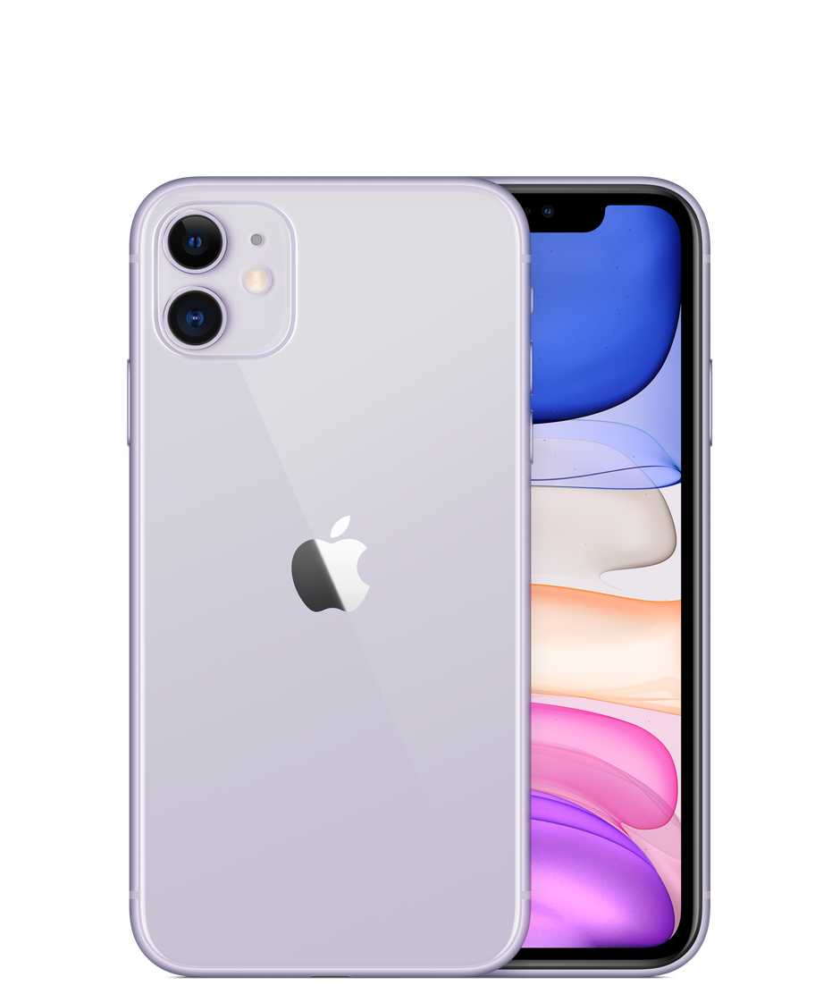
Hardware Cost Estimations
Google Cloud SQL for SQL Server and App Engine: $453.42 monthly
Only purchased once technical development begins in month 3 of the project timeline: $1813.68 total
Two Google Pixel 4 Phones: $1598 ($799 each)
Two iPhone 11 Phones: $1398 ($699 each)
Total for development cycle: $4809.68
Notes:
Cameron

Slide 19




Software Cost Estimations
Dart programming language: $0
Flutter UI toolkit: $0
Google Play Store developer registration fee: $25
Apple App Store developer fee: $99 annually
Total for development cycle: $124
Notes:
Cameron

Slide 20
Personnel Cost Estimations
4 developers ✕ $75,000 yearly salary ✕ 6 month development timeline
$75,000 yearly salary → $6,250 monthly salary
Total for development cycle - $150,000
Notes:
Cameron

Slide 21
Conclusion
Similar apps lack features that Digital Lifestyle Habit Tracker offers.
Original estimated total cost: $50,000
Total cost to develop this app: $154,933.68
Notes:
Rhea

